Slide 1
HUA Human research protection program

Slide 2
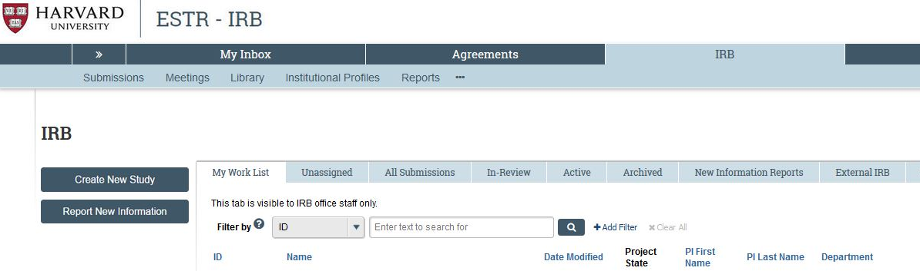
ESTR Website (irb.Harvard.edu)

Slide 3
Required reading
Human research protection Program plan
Investigator manual
HRP-101 (ESTR Library → General)
The purpose of this plan is to describe this Institution’s plan to comply with ethical and legal requirements for the conduct and oversight of Human Research.
The Human Research Protection Program is based on all individuals in this Institution along with key individuals and committees fulfilling their roles and responsibilities described in this plan.
HRP-103 (ESTR Library → General)
The Investigator Manual is designed to guide investigators and study staff through policies and procedures related to the conduct of Human Research that are specific to the Harvard University Area (HUA) IRB office.
General information regarding Human Research protections, as well as relevant federal regulations and guidance, has been incorporated throughout the manual where applicable.

Slide 4
Human Research Protection Program (HRPP) Plan

Slide 5

HRPP Mission
The mission of this Institution’s Human Research protection program plan is to protect the rights and welfare of subjects involved in Human Research that is overseen by this Institution.

Slide 6
HRPP SCOPE
All research (whether funded or not, and regardless of funding source) involving human subjects conducted by investigators under the auspices of the University-Area Institutions.
See HRP-101 HUA Human Research Protection Program Plan for specific categories of research overseen and not overseen

Slide 7
Ethical requirements
Outlined in 1979 “Ethical Principles and Guidelines for the Protection of Human Subjects of Research,” also known as “The Belmont Report”
Institutional baseline for all researchers, IRBs, and associated staff

Slide 8
The Belmont Report
Respect for Persons
  1) Individuals should be treated as autonomous agents,
  2) Persons with diminished autonomy are entitled to protection.
Beneficence
  1) Protecting the individual subjects against risk of harm
  2) Consideration of not only the benefits for the individual, but also the societal benefits that might be gained for research
Justice
  Who ought to receive the benefits of research and bear its burdens? This is a question of justice, in the sense of "fairness in distribution" or "what is deserved."

Slide 9
Legal requirements
Ensure all Human Research undergoes review by designated IRB
Apply additional regulations of relevant federal funding agency
  See HRP-318 WORKSHEET Additional Federal Agency Criteria
  See HRP-103 Investigator Manual
Apply FDA regulations when applicable

Slide 10

Key Players in hrpp plan
ALL MEMBERS OF THE INSTITUTION
INSTITUTIONAL OFFICIAL (IO)/ ORGANIZATIONAL OFFICIAL (OO)
HUA IRB/CUHS
INVESTIGATORS AND RESEARCH STAFF
OFFICE OF GENERAL COUNSEL (OGC)
OFFICE FOR SPONSORED PROGRAMS (OSP)
OFFICERS/DEANS

Slide 11
All Members of the Institution
All individuals within the Institution have the responsibility to:
  Be aware of the definition of Human Research.
  Consult the IRB when there is uncertainty about whether an activity is Human Research.
  Not conduct Human Research or allow Human Research to be conducted without review and approval by an IRB designated by the IO/OO.
  Report allegations of undue influence regarding the oversight of the Human Research Protection Program or concerns about the Human Research Protection Program to the IO/OO.
  Report allegations or finding of non-compliance with the requirements of the Human Research Protection Program to the IRB.

Slide 12
INSTITUTIONAL OFFICIAL/ORGANIZATIONAL OFFICIAL
Authority over
Overall Responsibility for
IRB budget
IRB membership and staffing
Reliance agreements
PI restrictions
Suspend, terminate, disapprove research
NOTE: May delegate these authorities (generally to IRB Director)
IRB reviews conducted by HRPP
HRPP policies/procedures
HRPP training initiatives
Independence of IRB from Institution
Report of complaints/concerns about research, as well as from IRB Chairs and Members
Signatory of the Federalwide Assurance (FWA)
See HRP-101 HUA Human Research Protection Program Plan for more information on the IO/OO

Slide 13
What is an IRB?
An Institutional Review Board is responsible for reviewing all research that involves human subjects
Enforce the Federal Regulations for the Protection of Human Subjects and other state and local regulations as they apply
IRBs have the authority to approve, disapprove, suspend, and terminate research involving human subjects

Slide 14

Institutional Review Board (IRB)
Panel of individuals from various backgrounds:
  Regulatory experts, scientists, faculty
  Diverse in race, gender, cultural background, etc.
  At least one:
    Prisoner representative
    Non-affiliated community member
Harvard University-Area IRB/ Committee on the Use of Human Subjects (CUHS)
Meets once per month

Slide 15
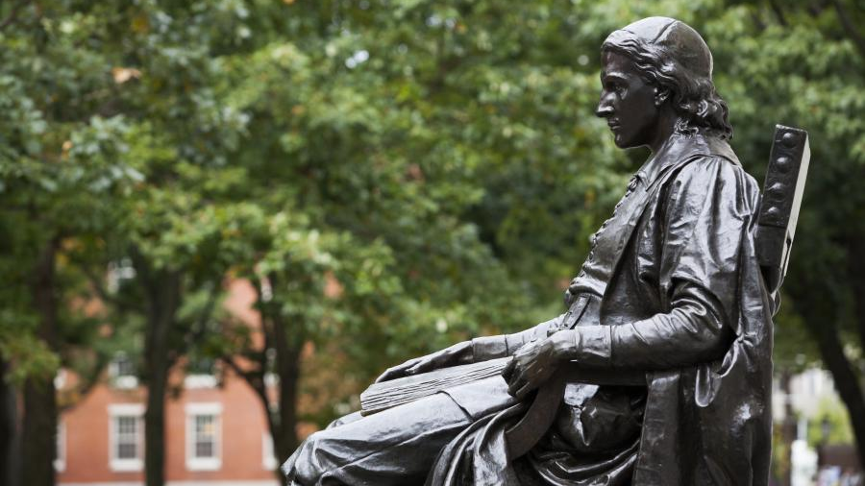
Harvard university area (“institution”)
Faculty of Arts and Sciences
John F. Kennedy School of Government
Harvard Graduate School of Education
Harvard Law School
Harvard Divinity School
Harvard Graduate School of Design
Harvard University Health Services
Radcliffe Institute for Advanced Study
Harvard School of Engineering and Applied Sciences
Harvard Business School

Slide 16

Principal Investigator Responsibilities
  Follow the Human Research Protection Program requirements described in HRP-103 Investigator Manual
  Comply with all determinations and additional requirements of the IRB, IRB chair, and IO/OO

Slide 17
Principal Investigator Responsibilities
Secure IRB approval prior to implementation
Conduct study according to IRB approved protocol
Submit Continuing Review, Modifications to IRB as required
Ensure adequate facilitates, equipment on site
Ensure study staff are qualified
Report new information

Slide 18
Study Staff Responsibilities
Human Subject Training
Conduct study according to IRB approved protocol
Report any discrepancies/issues/subject complaints to supervisor/PI and the IRB

Slide 19
OGC Responsibilities
  Provide advice upon request
  Determine whether someone is acting as an agent
  Determine who meets the definition of “legally authorized representative” and “children” when Human Research is conducted in jurisdictions not covered by policies and procedures
  Resolve conflicts among applicable laws
  Institutional adherence to EEA General Data Protection Regulations (GDPR)

Slide 20

OSP Responsibilities
OSP has the responsibility to review contracts and funding agreements for compliance with Human Research Protection Program policies and procedures

Slide 21
OFFICERS/DEANS
Oversee
Oversee the review and conduct studies in their department or school
Forward
Forward complaints and allegations to IRB or IO/OO
Ensure
Ensure studies conducted in their department or school has adequate resources

