Slide 1
HUA Human research protection program

Slide 2
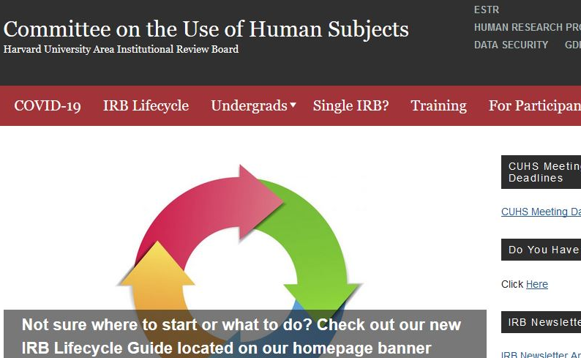
CUHS website
(cuhs.Harvard.edu)

Slide 3
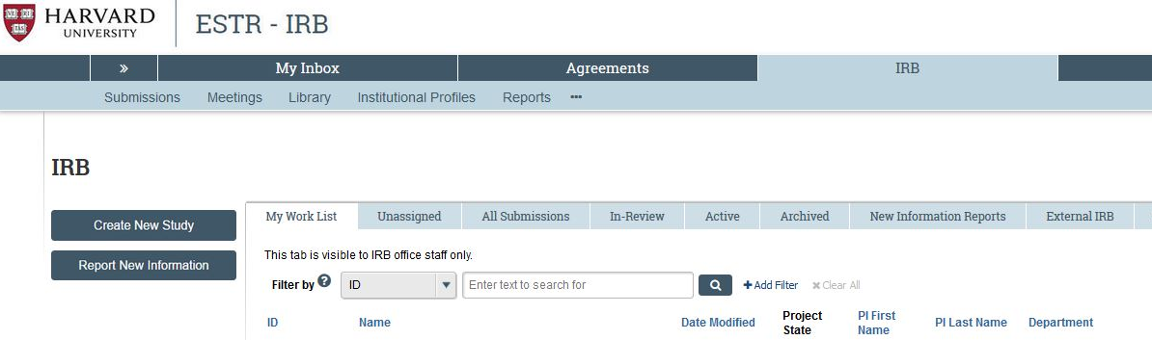
ESTR Website (irb.Harvard.edu)

Slide 4
Required reading
Human research protection Program plan
Investigator manual
HRP-101 (ESTR Library → General)
The purpose of this plan is to describe this Institution’s plan to comply with ethical and legal requirements for the conduct and oversight of Human Research.
The Human Research Protection Program is based on all individuals in this Institution along with key individuals and committees fulfilling their roles and responsibilities described in this plan.
HRP-103 (ESTR Library → General)
The Investigator Manual is designed to guide investigators and study staff through policies and procedures related to the conduct of Human Research that are specific to the Harvard University Area (HUA) IRB office.
General information regarding Human Research protections, as well as relevant federal regulations and guidance, has been incorporated throughout the manual where applicable.

Slide 5
Criteria for Approval

Slide 6

Before the Meeting
ASSESS
READ
ASK

Slide 7
IRB Member Handbook Tip
1. Read the consent document: The consent document should be in lay language and therefore should provide a good introduction to the research.
o Can you clearly describe the study after reading the Consent Form?
o Then read it again for readability (6th—8th grade level)
2. Read the protocol: Although the language may differ, the narrative and the consent form should be consistent in the description of the purpose, procedures, timeframe, risks and benefits, compensation and costs, confidentiality of data, etc.

Slide 8
CRITERIA FOR APPROVAL
  Risks to subjects are minimized
  Risks are reasonable in relation to benefits
  Selection of subjects is equitable
  Adequate provisions for monitoring data, ensuring its confidentiality and the safety of subjects
  Adequate provisions for privacy
  Safeguards for any vulnerable populations

Slide 9
Minimal risk means that the probability and magnitude of harm or discomfort anticipated in the research are not greater in and of themselves than those ordinarily encountered in daily life or during the performance of routine physical or psychological examinations or tests.

Slide 10




Risk does not only mean physical risk

Slide 11



Protected populations
CHILDREN (Subpart D)
PRISONERS (Subpart C)
PREGNANT WOMEN (Subpart B)

Slide 12

Potentially Vulnerable Populations
In addition to protected populations:
  Economically disadvantaged
  Cognitively impaired
  Low literacy
  LGBTQ+
  Racial/ethnic minorities
  Students/employees of investigator
  Undocumented status, refugees

Slide 13
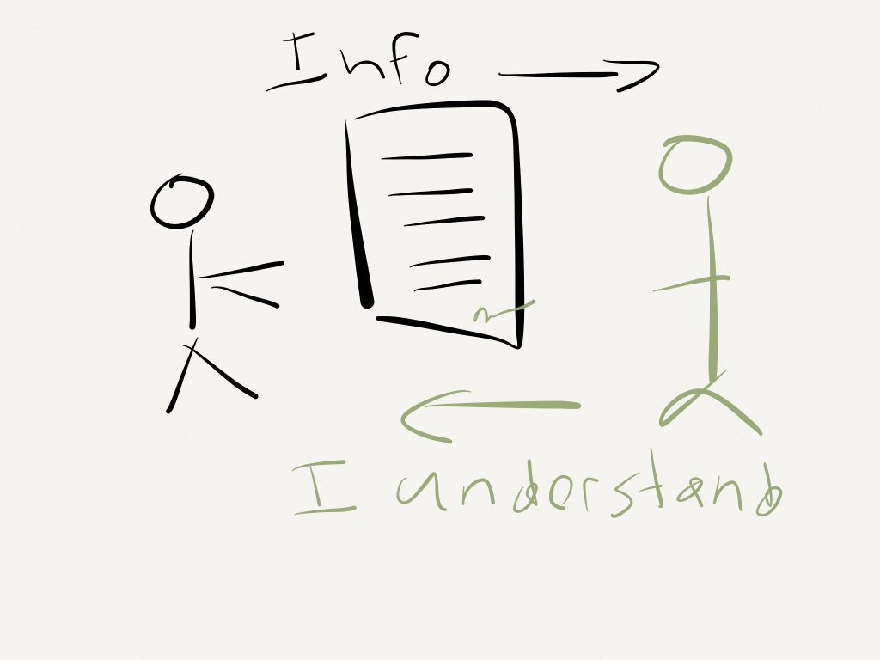
CRITERIA FOR APPROVAL
  Informed consent is obtained
      Information
      Comprehension
      Voluntary agreement
  Informed consent is documented

Slide 14
Informed consent
Informed consent – a process
Participants must understand
  purpose
  procedures
  risks and benefits
Agreement to participate must be voluntary
  Free of coercion or undue influence
Consent process begins with recruitment

Slide 15
Informed consent: Elements of Consent
  The study involves research
  Purpose and procedures, including duration
  Risks/ discomforts and benefits
  Confidentiality provisions
  Participation is voluntary
  No penalty or loss of benefits if do not participate or withdraw
  Future use of participant data
  Contact information
See HRP-314 WORKSHEET Criteria for Approval for additional DHHS elements as well as FDA and clinical trial requirements

Slide 16
Informed consent
Informed consent requirements may be altered or waived
Most commonly for…
  Deception: active misinformation
  Incomplete disclosure: withholding specific details
May omit purpose and/or procedures
  IF required of the research design (practicability)
  IF rights and welfare are otherwise protected

Slide 17

Criteria for Approval
For more on DHHS criteria for approval and informed consent see:
HRP-103 HUA Investigator Manual
HRP-314 WORKSHEET Criteria for Approval
HRP-410 CHECKLIST Waiver/Alteration of Consent Process
HRP-411 CHECKLIST Waiver of Documentation of Consent

